Slide 1
The Elements, Book I – Propositions 39 & 40
By: Audrey Holmes
Michael Marlett

Slide 2
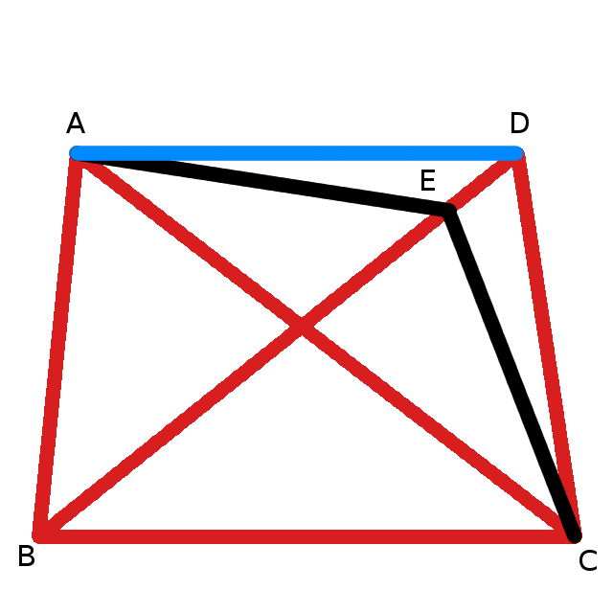
Proposition 39
Equal triangles which are on the same base and on the same side are also in the same parallels

Slide 3
Proof
ABC = DBC
Draw AD
Pick a point E on BD Draw AE parallel to BC.
Draw EC
ABC = EBC
Given
Postulate 1
Proposition 31
Postulate 1
Proposition 37
CONTRADICTION
If ABC = EBC, then EBC would have to be equal to DBC, which goes against Common Notion 1. Therefore, AE is not parallel to BC. Similarly, we can prove that neither is any other line except AD, therefore AD is parallel to BC.

Slide 4
Proposition 40
Equal triangles which are on equal bases and on the same side are also in the same parallels
The significance of 39 is that the areas are equal. Similarly, 40 is another case of equal areas, except that the triangles do not share a base

