Slide 1
ABu Jafar Muhammad ibn Mus al-Khwarizmi
“When I considered what people generally want in calculating, I found that it always is a number”
-Calculation by Restoration and Reduction
The Inventor of Algebra

Slide 2
al-Khwarizmi
Abu Jafar Muhammad ibn Mus al-Khwarizmi amassed mathematical knowledge from diverse cultures during his studies at the House of Wisdom to develop the techniques and practicality of Algebra, which in turn revolutionized mathematical thinking throughout the world.

Slide 3
Historical Background
al-Khwarizmi relied heavily on mathematical texts from other cultures and regions
The pre-existing network of knowledge within the Islamic Empire
Islamic culture united distant regions which created a melting pot of new ideas

Slide 4
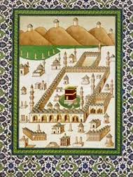
Islamic Empire
622 AD Prophet Muhammad ignited the spread of Islam religion
He attracted pilgrim followers as he fled from Mecca
Emphasized of toleration and equality
“The passion and egalitarian character of early Islam fired the imagination and won the devotion of many who came across it for the first time”

Slide 5
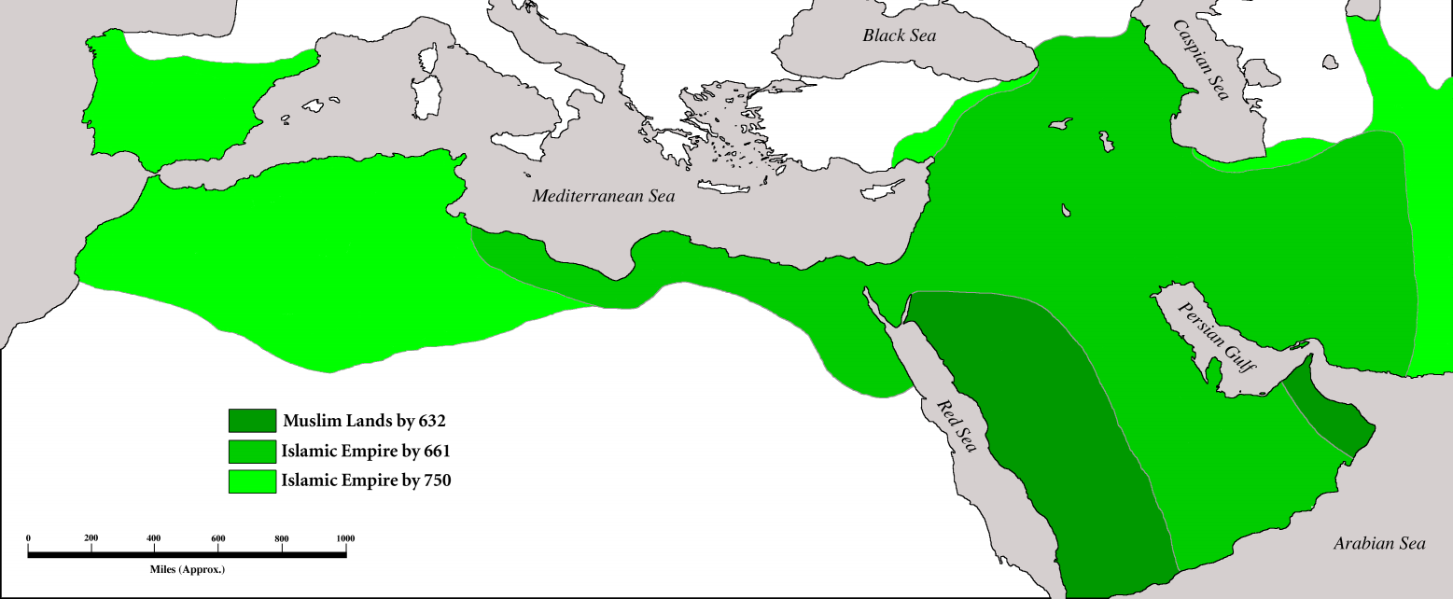
Umayyad Dynasty
Controlled empire between 661 and 750
Encouraged a degree of religious tolerance
Non-Muslims were discriminated and lacked social mobility
Expanded the Islamic empire into central Asia and India, Spain and Northern African

Slide 6
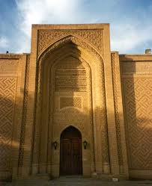
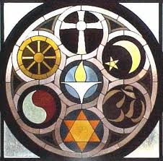
Abbasid Dynasty
Took over in AD 750
Strongly encouraged religious tolerance and cultural diversity
The Abbasid empire “restored ancient ties among historic centers of civilization across a huge landmass”
United regions of Islamic empire

Slide 7
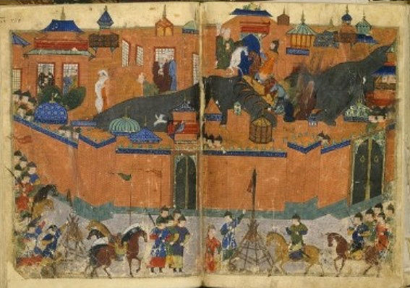
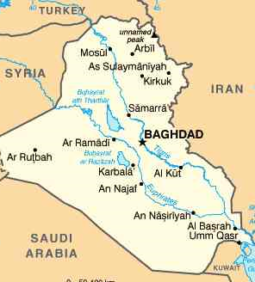
Baghdad
Established in 752
New capital of under Abbasid Dynasty
Located along Tigris River
Access to trade routes
Vibrant multi-cultural center
Demand for intellectual and scientific exchange
Knowledge of papermaking from China in 751

Slide 8
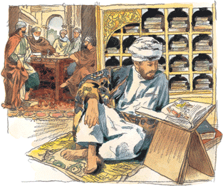
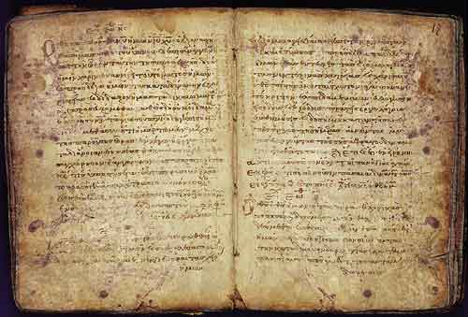
House of Wisdom
Founded between 813–833 in Baghdad
Made up of translation bureau, library, academy of scholars, and intellects from across the empire
Safeguard invaluable manuscripts within the empire
Translated foreign classics from Indian, Persian, and Greek scholars in Arabic
Arabic became universal language for scientific inquiry
Admiral, Alcohol, Almanac, Chemistry, Cotton, Mattress, Syrup

Slide 9
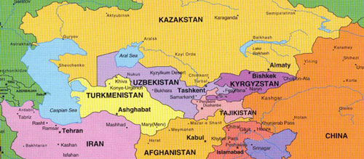
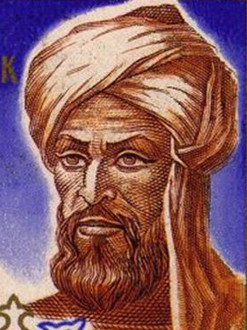
al-Khwarizmi’s Life
Lived between 780-850 AD
Family possibly originates from Khwarizm east of the Caspian sea in modern date Uzbekistan
Evidence that he was from Zoroastrian descent
Possibility that he converted to Islam to improve social status
Appointed as a member of House of Wisdom in 820

Slide 10
Practical Mathematics
Zij al-Sindhind
Earliest extent knowledge of Islamic Astronomy
Set of planetary table
Used mathematics to calculate horoscopes
Islamic faith needed precise astronomical calendars
Geography/Cartography
Mapped city locations of Asia and Africa
Improved previous approximations of locations based on latitude and longitude
The direction of Mecca for the use of prayer

Slide 11
Hisab al-jabr w’al-muqabala
“Calculation by Restoration and Reduction”
813-833 CE
Dedicated to Caliph al-Ma’mun
“the first systematic treatment of the general subject of algebra as distinct from the theory of numbers”
No symbols or written equations throughout his work
Mathematical processes are expressed using words
3 sections; Theoretical, Mensuration, Legacies

Slide 12
Theoretical
Explained the theoretical methods of algebra
It brought together common geometrical methods with a new method of algebra and arithmetic.
Made solving problems of inheritance much simpler and easier
It demonstrated the multiplication of unknown numbers.

Slide 13
Six different types of equations
He reduced all equations to six main types
Roots equal squares: bx = ax²
Roots equal numbers: bx = c
Squares equal numbers: ax² = c
Squares and roots equal numbers: ax² + bx = c
Roots and numbers equal squares: bx + c = ax²
Squares and numbers equal roots: ax² + c = bx
a, b, c all positive integers

Slide 14
Examples
Al-jabr → 2x + 5 = 8 - 3x → 5x + 5 = 8
Al-muqabala →5x + 5 = 8
5x + 5 – 5 = 8 – 5 → 5x = 3 (Roots equal numbers)
Al-jabr → (9/4)x +1/8 = 3 + (5/8)x → 18x + 1 = 24 + 15x
Al-muqabala → 18x + 1 = 24 + 15x
18x - 15x + 1 – 1 = 24 – 1 + 15x – 15x → 3x = 23

Slide 15
Al-Khwarizmi’s Solution
X² + 10X = 39
“One square, and ten roots of the same, amount to thirty-nine dirhams”; that is to say, what must be the square which, when increased by ten of its own roots, amounts to thirty-nine? The solution is this: you halve the number of the roots, which in the present instance yields five. This you multiply by itself; the product is twenty-five. Add this to thirty-nine; the sum is sixty-four. Now take the root of this, which is eight, and subtract from half the number of the roots, which is five; the remained is three. This is the root of the square which you sought for; the square itself is nine.”

Slide 16
Modern Algebraic solution
X² + 10X = 39
1. 10/2 → 5
2. 5² → 25
3. (X+5)² = 39 + 25 = 64
4. X + 5 = 8
5. X = 3

Slide 17
Modern Geometric Solution

Slide 18
Mensuration
Al-Khwarizmi gave equation for finding the area and circumference of a circle. He also gave a fairly accurate estimate of π
He also gives equations for computing volumes of cones, pyramids, and truncated pyramids.
Pythagorean theorem: The theorem states that for a right triangle, the square of the hypotenuse c is equal to the sum of the squares of the two short sides a and b.

Slide 19
Legacies and Inheritances
In Islamic law it is straightforward on how an estate is distributed among family members.
It becomes complicated;
When a certain amount is bestowed to a stranger.
When the deceased has debt.
When the deceased has bestowed some land to a mother, spouse, sisters, brothers, and a stranger.

Slide 20
Example of Legacies Problem
A man dies, leaving his mother, his wife, and two brothers and two sisters by the same father and mother with himself; and he bequeaths to a stranger one-ninth of his capital.

Slide 21
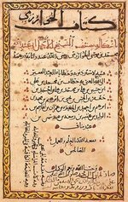
Treatise on Hindu Reckoning Arithmetic
Also called Algorithmi de numero indorum (Calculation with Indian Numerals)
Written around 825 CE after Algebra.
No extant text left, only Latin translations.

Slide 22
Why did he write this?
“Concerning the numbering of the Indians by means of IX symbols in their universal system of numbering, for the sake of its ease and brevity, so that this work, to be sure, might as the smallest, and whatever there is in its as result of multiplication and division, also addition and subtraction, etc.”
He wanted to make practical mathematics as easy as possible, and Hindu numerals offered a much easier way to solve problems in comparison with previous methods.

Slide 23
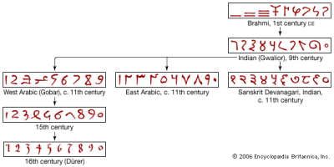
Hindu Numerals cont..
Introduced Hindu numerals 1,2,3,4,5,6,7,8,9 and 0
Introduced the positional value system
But not decimal fraction
He showed how easy it was to write large numbers with zero instead of the previous method.
Showed how to add, subtract, multiply, and divide with these new numerals and fractions.

Slide 24
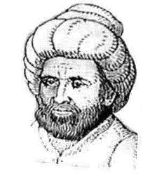
Controversy
Scholars question the originality of Al-Khwarizmi’s work
Argue that Al-Khwarizmi merely complied and organized the principles of algebra from the mathematic work of other cultures
Exposure to Influences at House of wisdom

Slide 25
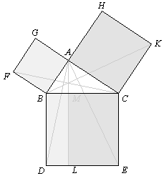
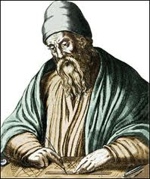
Greek Geometrical Influences
He had access to Greek texts in the House of Wisdom
Scholars argue that first 10 proofs in Book II of the elements were proved independent of each other
This emphasizes the “the power of the method of geometrical algebra”
However, lack of evidence that algebra was directly influenced by Greek geometry
Al-Khwarizmi’s technique for a geometrical solution prove that Al-Khwarizmi “remained outside the sphere of Greek influence”

Slide 26
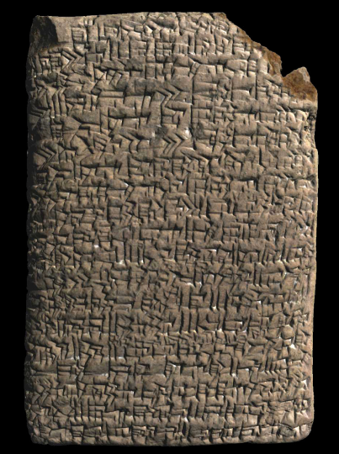
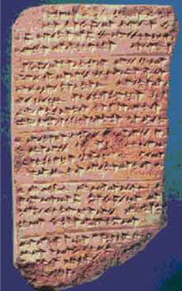
Mesopotamian Influences
Exposed Mesopotamian influences at the House of Wisdom
No concrete evidence to connect Indian or Babylonian texts with al-Khwarizmi
Mathematicians ruled out the direct influence from Indian algebra based on distinct differences in quadratic bases
Scholars argue a connection between Babylonian equations that used geometry and al-Khwarizmi’s second degree equations
Like the cuneiform tablets we looked at in class
Only hypothetical speculation of a link between Babylonian mathematics and al-Khwarizmi

Slide 27
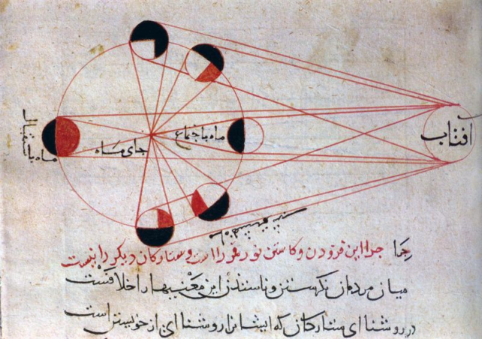
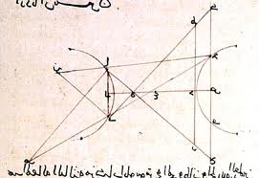
Arabic Culture
Influenced by texts of Greek, Indian, local Arabic mathematics
Development of Arabic sciences lead to demand for comprehensive translations from ancient texts
Arab mathematicians and scientists were not directly searching for ideas to“steal from ancient texts
A discovery within mathematics would return Arab scholar back to ancient Greek texts, which were then translated, edited and improved upon
Different perspective about originality

Slide 28
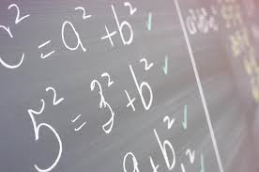
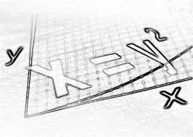
Controversy Conclusion
Scholars agree: It was “the first systematic treatment of the general subject of algebra as distinct from the theory of numbers”
Al-Khwarizmi was definitely influenced by previous cultures mathematic texts
He independently possessed the creativity and genesis to fuse diverse aspects from multiple cultures of mathematics to establish the foundation of algebra
Foundation for future developments in mathematics

Slide 29
Al- Khwarizmi’s Influences
Al- Khwarizmi’s work revolutionized future mathematical thinking
Algebra, Hindu numerals, and astronomical theories
People were able to use Al-Khwarizmi’s past works and combine them with different cultures to develop new ideas

Slide 30
Europe
Kitab al-Jabr wa’l Muqabalah
“It was from this work that Europe later learned the branch of mathematics known as algebra”
Caliph al-Ma’mun
“Encouraged me to compose a work on algebra confining it to the fine and important parts of its calculation for practical purposes”

Slide 31
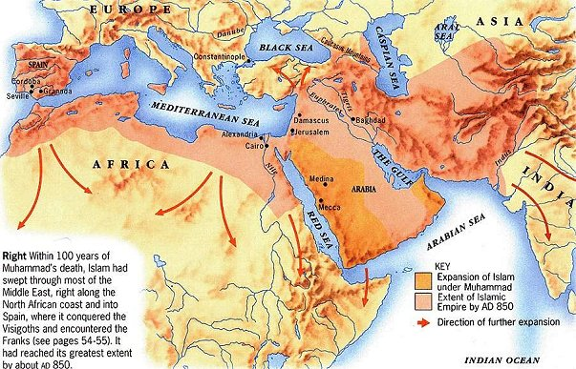
Hindu-Arabic Numerals
De Numero Indorum
Al-Khwarizmi’s Hindu-Arabic numerals “became digits of the western world”
Europe adopted the Hindu-Arabic numerals as they were used in Spain
Western Europe adopted the numerals including the zero sign from Muslim Spain and Northern Africa
Landed in Italy
New notation came to be known as that of Al- Khwarizmi

Slide 32
Origins of the Names
Treatise on Hindi Numerals translated in Latin to Algoritmi de Numero Indorum (Al- Khwarizmi Concerning the Indian Art of Reckoning)
Al- Khwarizmi → Alchoarismi→ Algorismi→ algorismus→ Algorisme→ Algoritmi→ Algorism→ Algorithm
Algorithm – “A procedure for solving a mathematical problem in a finite number of steps that often involves repetition of an operation”

Slide 33
Influence of the Zij
Ibn Mu’adh al-Jayyani
The leading Andalusian astronomer
Tabulae Jahenen
Set of astronomical tables directly based on Al-Khwarizmi’s Zij al-Sindhind
Able to take Khwarizmi’s work and further developed mathematical thinking for practical purposes
Adapted Zij for the longitude of Jaen, his hometown, and he took into account the equinoxes

Slide 34
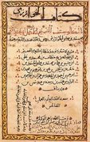
Hisab al-Khataayn
“Rule of Double false position”
Popular method when solutions to linear equations were difficult
Rule brought to Europe by the Arabs and is found in the earlier works of Al-Khwarizmi

Slide 35
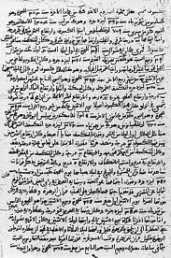
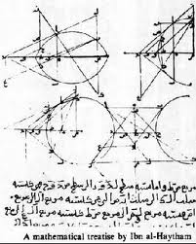
Arabic Influences
Abu Kamil ibn Aslam
850-930 AD
Quotes directly from Al-Khwarizmi’s works
Copies many of his problems and examples

Slide 36
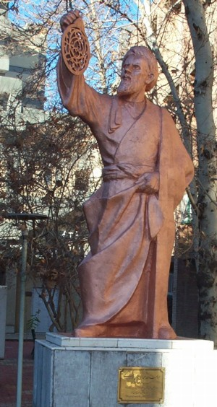
Hebrew
Mishnat ha-Middol
1092-1145 AD
Abraham bar Hiyya and Abraham ibn Ezra
Oldest mathematical text in Hebrew
Gives practical rules for mensuration
Section on the solution of quadratic equations with geometric analogues
This section “was strongly influenced by al-Khwarizmi’s algebra”

Slide 37
Descartes
“Geometry” was inspired by what Descartes called the “true mathematics”
He proved geometric basis for algebraic operations
This technique had already been done by Al-Khwarizmi
Descartes work “produced great progress in algebra and other mathematics”
Work gave rise to a new branch of mathematics called analytical geometry

Slide 38
Fibonacci
Considered one of the greatest mathematicians of all time
Wrote The Book on Calculation, the first work in Christian Europe on algebra and geometry
The fifteenth and final chapter of Fibonacci’s influential book, Liber Abbaci, depended heavily on ideas of al-Khwarizmi
Spread the numerals of Khwarizmi through Europe with his statement, “The nine Indian numerals are 9,8,7,6,5,4,3,2,1. With these nine and 0, any desired number can be written.”

Slide 39
Questions

