Slide 1
Al-Andalus
How an Intellectual Golden Age and A Common Scholarly Goal Triumphed During a Tumultuous Age in Muslim Spain

Slide 2
History of Al-Andalus
Death of Prophet Muhammad, many leaders came to power over Muslims
Spread Islam
Muslim developments
In 711, Muslims from North Africa invaded Southern Spain
Tolerance amongst Christians, Jews and Muslims

Slide 3
History
Caliphate of Cordoba ruled from 929 to 1031 CE.
al-Andalus became center for learning
Tolerance among scholars working to preserve and expand mathematics
Translated Greek works to Arabic
Collapsed in 1031

Slide 4
History
Caliphate of Cordoba collapsed in 1031
Civil war
Many independently ruled Muslim cities
Restoration of Christian rule in 1085 C.E.
Christian monarch Alfonso VI of Castile
Moved capital to Toledo
Muslim scholars to translated Arabic to Latin to help spread previous developments

Slide 5
History
For the next 200 years, Muslims and Christians battled for control of the area in the Reconquista
Muslim, Jewish, and Christian scholars continued to share a rich culture
Translations from Arabic into Latin

Slide 7
Abu Maslama al-Majriti
Born in Madrid around 950
Leading mathematician and astronomer of the time in al-Andalus
Later, moved to Cordoba during rule of the Caliphate of Cordoba

Slide 8
al-Majriti
Preserved mathematics: studied, translated, and elaborated on Ptolemy’s “Almagest” and “Planisphaerium”
“Almagest”
Treastise on movements of planets and the sun.
Based on assumption that Earth was the center of the universe
Criticized Ptolemy’s ideas and improved upon them

Slide 9
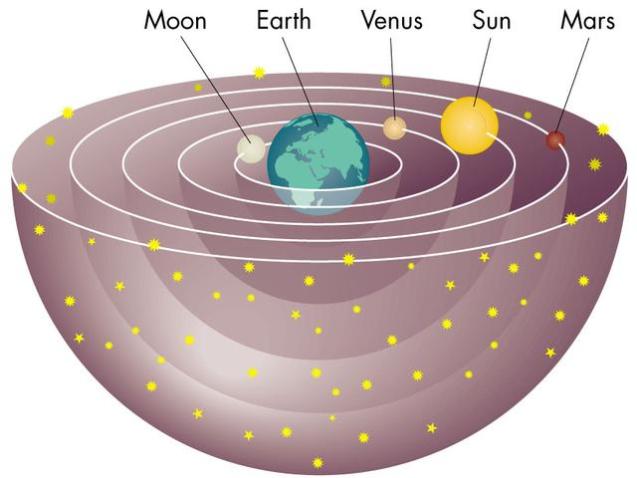
Ptolemy’s Model of the Solar System, with Earth at its Center

Slide 10
Spherical Geometry
Ptolemy- spherical trigonometry
Calculated distances between the planets
V is the position of the observer, and PQR are points on a sphere centered at V, the celestial sphere.
Shows how astronomy used trigonometry (sine and cosine)
Today replaced with linear algebra and plane geometry)

Slide 11
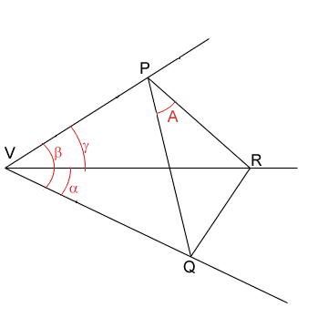
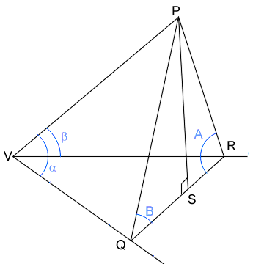
Spherical Geometry, Cont.

Slide 12
al-Majriti
Founded a school of scholars in Cordoba, taught there
Attended by renowned scientists and mathematicians
Students played a critical role in spreading his knowledge
European Christians translated his works from Arabic to Latin

Slide 13
al- Zarqali
Mathematician under caliphate rule
Born in Toledo in 1029, later moved to Cordoba
Studied Babylonian astronomy and Ptolemy’s works
Contributed to the Tables of Toledo

Slide 14
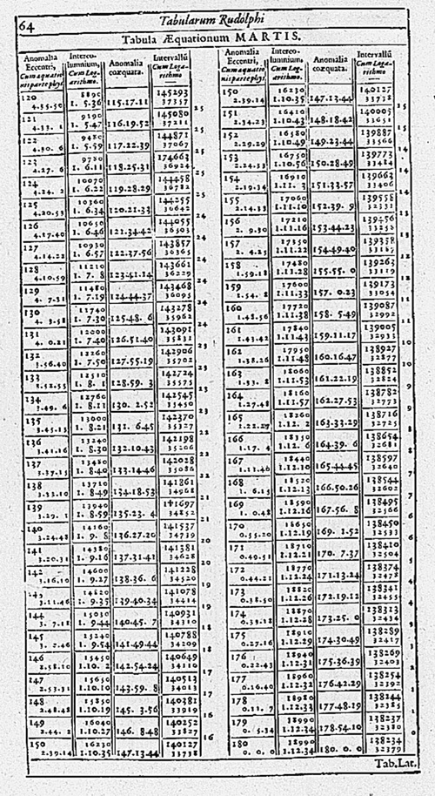
al-Zarqali
Tables of Toledo
Predicted the movements of the sun, moon, and planets relative to the fixed stars
Predicted solar and lunar eclipses
They were continually being
improved and revised

Slide 15
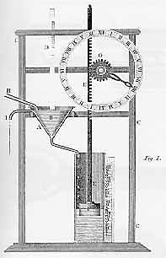
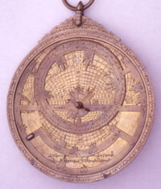
al-Zarqarli’s Other Significant Developments
Water Clock
Astrolabe

Slide 16
Adelard of Bath
British scholar, trained in Arabic in al-Andalus
Translated al-Khwarizmi’s Sindhind
Tables on movement of sun, moon, planets
Translated Euclid’s Elements from Arabic to Latin
became the basis for subsequent versions of the Elements
Used scientific reasoning over supernatural causes
- looked to explain phenomena in terms of natural rather than supernatural causes

Slide 17
Gerard of Cremona
Translator of the time during Christian rule
Translated 71 works from Arabic into Latin
Works included geometry, mathematics, and related sciences
Allowed elements of ancient Greek and Arabic science to be passed to the West
Translations represented scientific approach to nature rather than theological attitude

Slide 18
al- Qalasadi
Born in Bastah, al Andalus (1412) and died in Grenada (1500)
Introduced mathematical concepts
One of the last Arabic mathematicians to live in al-Andalus
Algebraic symbolism
Wrote algebraic symbols as short Arabic words or letters

Slide 19
al-Qalasadi
Algebraic Symbolism
wa meaning "and" for + illa meaning "less" for - fi meaning "times" for × ala meaning "over" for ÷ j from jadah meaning "root" sh from shay meaning "thing" (x, the unknown) m from mal for x2 k form kab for x3 l from yadilu for =
Intermediate step between al-Khwarizmi’s rhetorical algebra and our modern day algebraic symbolism

Slide 20
al-Qalasadi
Wrote several books:
“The Clarification of the Sciences”
“Unveiling the Science of Arithmetic”
“Unfolding the Secrets of the Use of the Dust Letters”
Late work was used in teaching arithmetic in North Africa

Slide 21
“No branch of mathematics is more visible in Muslim culture than geometry.”

Slide 22
Symmetries in Tile Patterns
Symmetry- property of invariance under a transformation
Basic unit shifted multiple times to create a pattern
Shift of an infinitely extended pattern would preserve the original design

Slide 23
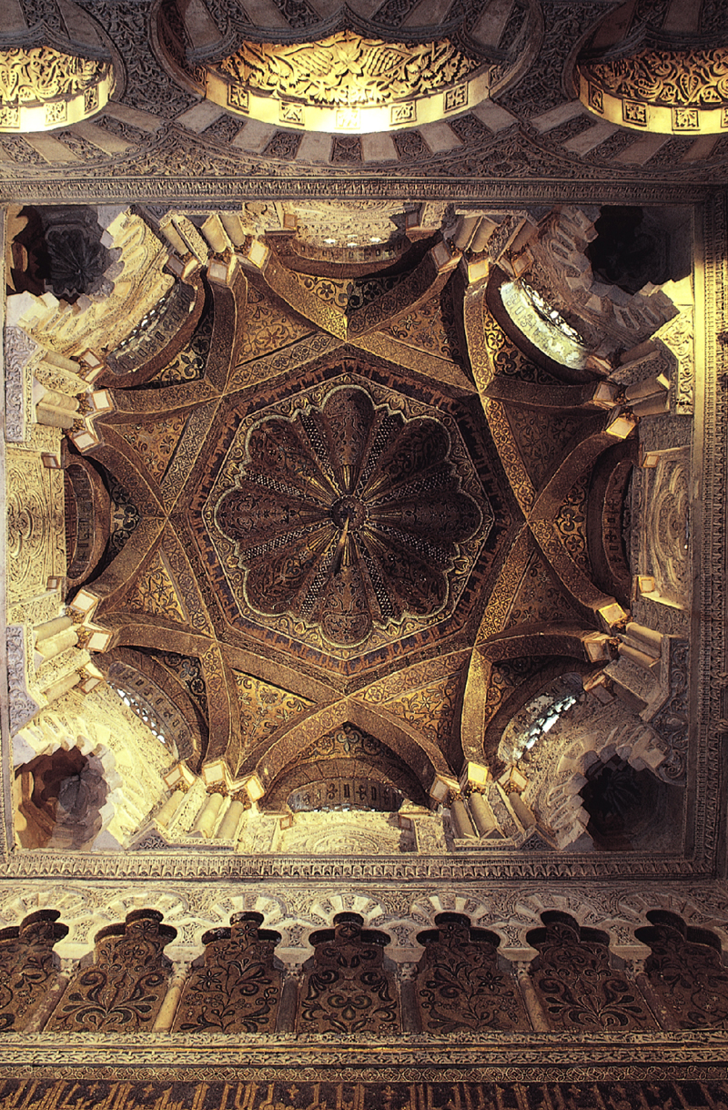
Visible Geometry
Ruler and compass constructions
Used simple polygons and angle measurements to create complex designs

Slide 25
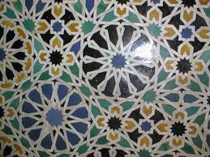
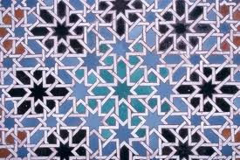

Slide 26
Arabesque Style
Present in both the Alhambra and the Great Mosque at Cordoba
Repeating geometric forms combined, duplicated, and interlaced in intricate combinations that often included Arabic calligraphy
Some styles more geometric, others more scrolling and plant-like

Slide 27
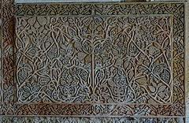
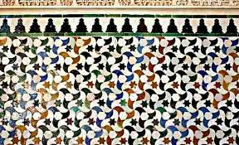
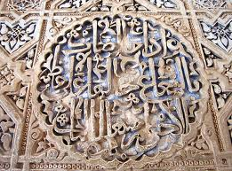
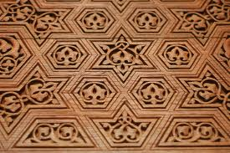

Slide 29
Importance of Ratios and Proportions the Alhambra
http://www.youtube.com/watch?v=Mfm9RsEYCsk
(3:34 to 6:14)

Slide 30
In Conclusion…

