Slide 1
So, why is it called the Montserrat program, anyway?
MONT 104N – August, 2018

Slide 2
Montserrats you may know
A line in the cheesy 1980’s Beach Boys song Kokomo “ … that Montserrat mystique ... ”
A Caribbean island (what the Beach Boys were referring to) – site of a major volcanic eruption in 1995
A town on the North Shore of Massachusetts
A (somewhat uncommon) woman’s name in Spain and Latin America
The first-year seminar program at Holy Cross
But what’s the connection? Where does it come from?

Slide 3
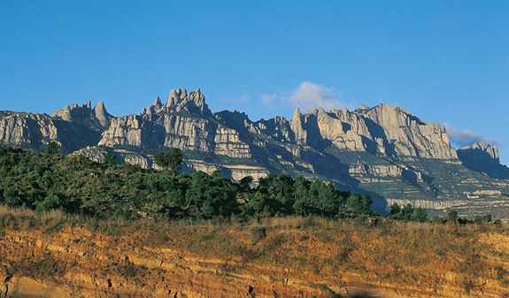
The name comes from this special place

Slide 4
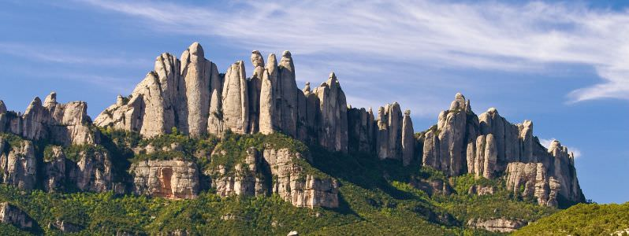
An extraordinary mountain in Spain

Slide 5
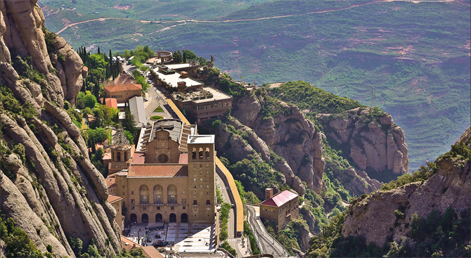
Site of an old Benedictine monastery

Slide 6
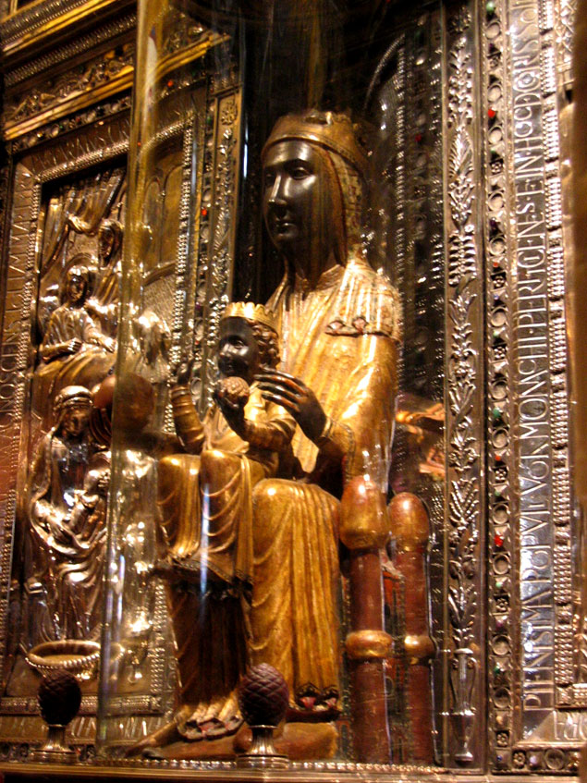
Home of a beloved Madonna

Slide 7
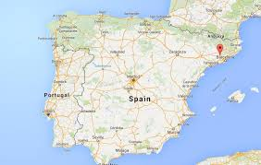
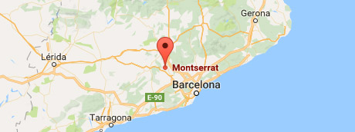
Location – just northwest of Barcelona

Slide 8
And a turning point
But most importantly for Holy Cross, the mountain and monastery of Montserrat was also the site of a turning point in the life of St. Ignatius Loyola, the founder and first Superior General of the Society of Jesus -- the Jesuit order of religious (priests and brothers) who founded and maintain this college.

Slide 9
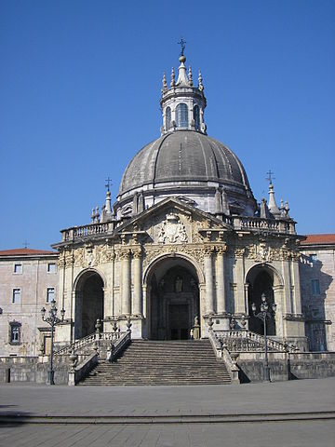
A brief timeline
1491 – Inigo de Loyola y Onaz is born in castle of Loyola
This sanctuary in Azpeitia was later built around it --
Inigo starts life as a worldly soldier and courtier
1521 -- Seriously wounded at battle of Pamplona
Difficult recovery takes six months
During this time he undergoes a spiritual conversion,
resolves to devote himself to a religious life
and travel to the Holy Land (Jerusalem)

Slide 10
In his own words,
“He continued his way to Montserrat thinking, as he usually did, of the achievements he was going to perform for the love of God. Because his thoughts were fully occupied with exploits, such as those he had read in Amadis of Gaul and other like books, similar thoughts also came to mind. He therefore determined to keep a night’s vigil over his arms; he would neither sit nor lie down, but would stand and kneel before the altar of Our Lady of Montserrat, where he had decided to set aside the garments he was wearing and clothe himself in the livery of Christ … [after consulting with a confessor] ... he arranged to leave his mule behind and hang up his sword and dagger at Our Lady’s altar in the church ... ” (emphasis added)
A Pilgrim’s Journey (Autobiography of Ignatius of Loyola)

Slide 11
Ignatius’ later life
1523 – travels to Holy Land but is not allowed to stay there
1524 – 1534 – study at universities in Alcala, then in Paris; earns a Master’s degree in Theology; he preaches and creates the Spiritual Exercises (various forms of which are offered through the Chaplain’s office at Holy Cross) drawing on his own conversion experience
1539 – Society of Jesus formed in Rome with six other young men including Saints Peter Faber and Francis Xavier
1540 – Pope Paul III formally approves the Society, which then expands rapidly
1541 – Francis Xavier’s mission to India and Japan begins; he dies 1552 waiting to travel to China
1548 – First Jesuit College established at Messina in Sicily, and secondary and higher education thereafter becomes the Jesuits’ primary mission
1556 – Ignatius dies in Rome

Slide 12
Montserrat at Holy Cross
Following the way that Ignatius’ experience at Montserrat marked the turning point to his later life, we hope that, at least for some of you, the experiences you have in the Montserrat program this year will help you to identify
the ways you will spend the rest of your time at the College, and
what your life’s work will be.

