Slide 1
Proposition 33
Alex and Lizzie

Slide 2
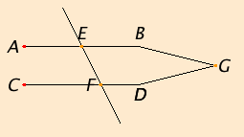
Proposition 27
If the straight line EF falls across the straight lines AB and CD and the alternate angles AEF and EFD are equal to one another:
Then straight line AB and straight line CD are parallel.

Slide 3
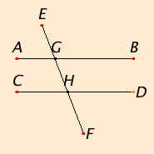
Proposition 29
When EF falls across parallel lines AB and CD:
Alternate angles AGH and GHD are equal
Corresponding angles EGB and GHD are equal
Sum of interior angles on the same side is equal to two right angles, like BGH and GHD

Slide 4
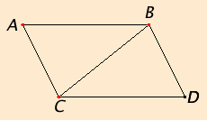
What Proposition 33 is proving:
Straight lines which join the ends of equal and parallel straight lines in the same directions are themselves equal and parallel.

Slide 5
Given Information
Lines AB and CD are equal and parallel
Lines AC and BD join with AB and CD
The goal of this proposition is to prove that AB and CD are also equal and parallel.

Slide 6
Applying Postulate 1 and Proposition 29
Join point B and point C (post.1).
Since line AB is parallel to line CD, and line BC falls upon them, alternate angles ABC and BCD are equal to one another (prop.29).

Slide 7
Applying Proposition 4
AB = CD
BC is common to both triangles
Then the triangles have two equal sides (AB + BC and BC +CD) and we know that (previous step) angles ABC and BCD are equal
So we can apply Proposition 4 (SAS)
Triangle ABC is congruent to triangle DCB.
Angle ACB is equal to CBD

Slide 8
Applying Proposition 27
Since line BC falls across lines AB and CD and makes the alternate angles (ACB/CBD and ABC/BCD) equal to one another, lines AC and BD are parallel and equal (post.27).

Slide 9
What Proposition 33 proves:
Straight lines which join the ends of equal and parallel straight lines in the same directions are themselves equal and parallel.

