Slide 1
Was “Pythagoras” a Babylonian?
Amherst Mathematics Colloquium
September 29, 2011
John Little
little@mathcs.holycross.edu

Slide 2
Plan for this talk
The “Pythagorean” (?) theorem
Mathematics of the Old Babylonian period
Different interpretations of some key cuneiform tablets: YBC 6967, YBC 7289, Plimpton 322
To what extent did these Babylonian calculations anticipate the general Pythagorean theorem, other later results?
Should we care who found these ideas first?

Slide 3
Who was Pythagoras?
Greek philosopher, mathematician, mystic/religious leader from Samos
Lived ca. 570 – 495 BCE (?)
Very little is known about his life or mathematical work
The $a^{2}+b^{2}=c^{2}$ relation for sides in a right triangle was only ascribed to him by much later Greek writers (first perhaps 500 years later)

Slide 4
Some interesting tidbits
A Greek tradition – Pythagoras was said to have traveled widely
to Egypt and Babylon, and
possibly even as far as India
In general, the Greeks were more than willing to acknowledge their indebtedness to Egypt and Mesopotamia for the basis of much of what they took and developed

Slide 5
The Sulba Sutras
A collection of Indian mathematical texts that can be traced back to the 8th century BCE – connected with construction of ritual fire altars for Vedic religion
Reveal extensive knowledge of integer Pythagorean triples , plus
Statement of the general theorem, and
A proof in a special case

Slide 6
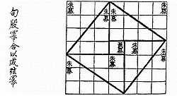
Zhou Bi Suan Jing
Chinese “Arithmetical Classic of the Gnomon”
Earliest surviving copies about 100 BCE, but thought to date from much earlier (perhaps 1100 BCE)
Contains a chapter on the ``go-gou’’ theorem

Slide 7
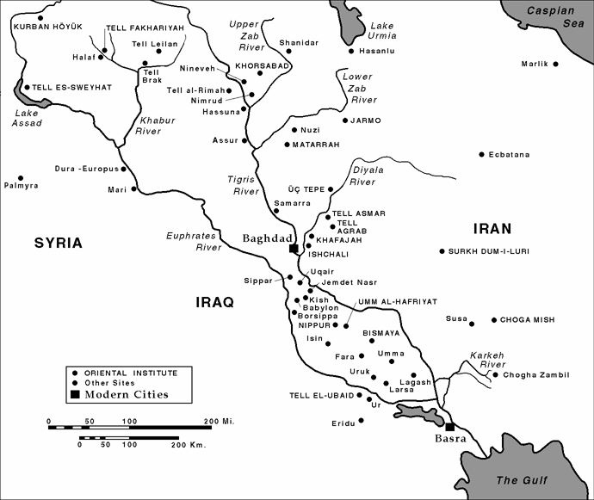
Ancient Mesopotamia
the ``land between the rivers'' – Tigris and Euphrates – mostly contained in current countries of Iraq, Iran, Syria.

Slide 8
A very long history
ca. 5500 BCE -- First village settlements in the South
ca. 3500 - 2800 BCE -- Sumerian city-state period, first cities, first pictographic texts
ca. 3300 - 3100 BCE -- first cuneiform writing
created with a reed stylus on a wet clay tablet, then sometimes baked
In a dry climate, these records are very durable!

Slide 9
Cuneiform writing
Different combinations of up-down and sideways wedges were used to represent syllables
Was used to represent many different spoken languages over a long period – 1000 years +
We'll see the way numbers were represented in this system shortly.
Used for everything – bureaucratic records, literature, mathematics, ...

Slide 10
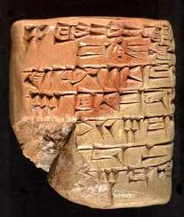
A tablet with cuneiform writing
Note the limited collection of forms you can make with a wedge-shaped stylus:

Slide 11
Concentrate on southern area
ca. 2800 - 2320 BCE -- Early Dynastic Period, Old Sumerian literature
ca. 2320 - 2180 BCE -- Akkadian (Sumerian) empire, first real centralized government
ca. 2000 BCE -- collapse of remnant of Sumerian empire
ca. 2000 - 1600 BCE -- Ammorite kingdom -- "Old Babylonian Period"-- Hammurabi Code, mathematics texts, editing of Sumerian Epic of Gilgamesh (~ contemporaneous with Egyptian “Middle Kingdom” and Ahmes and Rhind papyri.)

Slide 12
Babylonian mathematics
Apparently taught in schools for scribes connected with governmental and religious centers
Used a distinctive base-60 positional number system, including base-60 fractions (but no symbol for zero, so sometimes ambiguous!)
Featured very extensive and sophisticated calculations
No evidence of a concept of general proof – everything based on examples or models leading to general methods.

Slide 13
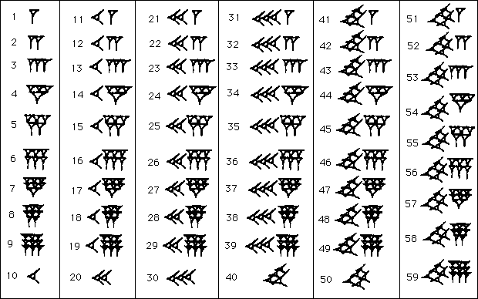
The number system

Slide 14
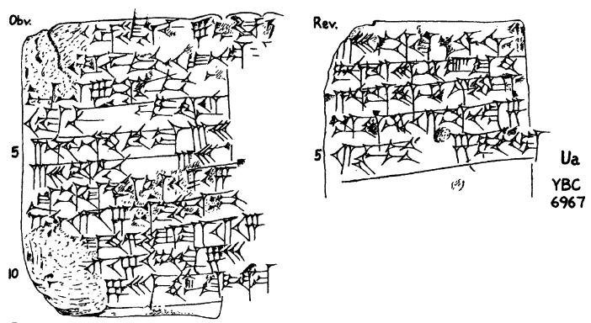
A famous mathematical text
The tablet known as ``YBC 6967'' (Note: YBC = “Yale Babylonian Collection”)

Slide 15
YBC 6967
Recognized as a mathematical text and translated by Otto Neugebauer (1940's).
Essentially a mathematical problem (probably set to scribal students in the city of Larsa) and a step-by-step model solution.
The problem: A number x exceeds 60/x by 7. What are x and 60/x ?
Comment: Many similar tablets with variants of this problem have also been recognized.

Slide 16
The Babylonian solution
Paraphrase of Neugebauer's translation of the solution given on YBC 6967:
Halve the 7 to get 3.5
Square the 3.5 to get 12.25
Add 60 to get 72.25, and extract square root to get 8.5
Subtract the 3.5 from 8 to get 5, which is 60/x
Then x = 12

Slide 17
What's going on here?
Possible explanation: The original problem asks for a solution of x = 60/x + 7, or
x² – 7x – 60 = 0.
Larger solution of x² – px – q = 0, p,q > 0 can be written as: x = p/2 +√((p/2)² + q)
This is exactly what the “recipe” given in the YBC 6967 solution does(!)

Slide 18
Perils of doing mathematical history
Does that mean that the Babylonians who created this problem text knew the quadratic formula?
Best answer to that one: While they certainly would have understood it if explained, from what we know, they just did not think in terms of general formulas that way. So, probably no, not really.
Conceptual anachronism is the (“amateur” or professional) mathematical historian's worst temptation.

Slide 19
So what were they doing?
Neugebauer's answer – it could have been ``quadratic algebra'' based on the identity (*) ((a + b)/2)² – ((a – b)/2)² = a b
Letting a = x, b = 60/x, then a – b = 7 and a b = 60 are known from the given information.
The steps in the YBC 6967 solution also correspond exactly to one way to solve for a and b from (*)
But isn't this also possibly anachronistic??

Slide 20
More recent interpretations
More recent work on Babylonian problem texts including YBC 6967 by Jens Hoyrup and Eleanor Robson has taken as its starting point the “geometric flavor” of the actual language used in the solution:
Not just “halve the 7” but “break the 7 in two”
Not just “add” the 3.5² to the 60, but “append it to the surface”
Not just “subtract” 3.5, but “tear it out.”

Slide 21
YBC 6967 as “cut and paste”
So in fact Hoyrup proposed that the solution method given on YBC 6967 could be visualized as “cut and paste” geometry like this – [do on board].
The (subtle?) point: this is mathematically equivalent to Neugebauer's algebraic identity (*), of course. But Hoyrup argues that it seems to “fit” the linguistic evidence from the text and what we know about the cultural context of Babylonian mathematics better.

Slide 22
Babylonian geometry(?)
More importantly, it serves to plant the idea that (contrary to what Neugebauer thought and wrote many times), Babylonian mathematics contained significant geometric thinking as well as algebraic ideas.
Finally, note how close we are here to one of the well-known dissection/algebraic proofs of the Pythagorean Theorem, and the Chinese go-gou theorem(!)

Slide 23
Was “Pythagoras” Babylonian?
(Had it ever occurred to you that the quadratic formula and the Pythagorean theorem are this closely related? It certainly never had to me before I started looking at this history(!))
What can we say about whether the Babylonians really understood a general Pythagorean Theorem?
There are many tantalizing hints, but nothing definitive (a difference between mathematics itself and its history!)

Slide 24
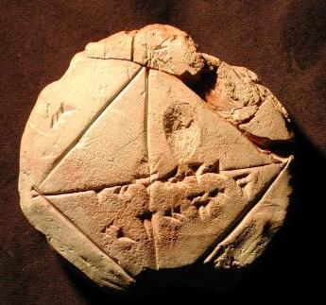
A First Piece of Evidence
The tablet YBC 7289

Slide 25
YBC 7289
The numbers here are:
On one side 30 – evidently to be interpreted the fraction 30/60 = ½
The top number written on the diagonal of the square are: 1.24:51:10 – in base 60, this gives approximately 1.414212963...
Note: √2 ≐ 1.414213562...
The lower one is .42:25:35 – exactly half of the other one.

Slide 26
How did they do it?
Short, frustrating answer – as with so many other things, we don't know.
However, a more common approximation of √2 they used: √2 ≐ 17/12 ≐ 1.416666 can be obtained starting from x˳= 1.0 by two iterations of x_n = (x_{n-1} + 2/x_{n-1})/2 (“Newton's Method” on x² – 2 = 0).
Whoever created this tablet may have done more extensive computations of a related sort (but not exactly that).

Slide 27
More evidence?
There is another very well-known tablet known as “Plimpton 322'' that gives more evidence of the degree to which the Babylonians appreciated the general $a^{2}+b^{2}=c^{2}$ relation and integer Pythagorean triples

Slide 28
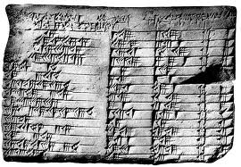
Plimpton 322
The most famous (and enigmatic!) Old Babylonian mathematical text

Slide 29
Interpreting Plimpton 322
The contents of this tablet form essentially a table of integer ``Pythagorean triples''
For instance, row 11 of the table includes the numbers c = 75, a = 45 from the nonprimitive triple (45,60,75) = 15 (3,4,5).
Neugebauer interpreted this table as a systematic application of the generating formulas related to (*) from before:
a = p q b = p² – q² c = p² + q²

Slide 30
Interpreting Plimpton 322, continued
The first (leftmost) column contains the values of (c/b)² for the corresponding triangle. So was this the first trigonometry table?? (Discussed by R. C. Buck in a Monthly article from 1980.)
Doubtful – probably anachronistic(!)
Evidence that the Babylonians appreciated the general Pythagorean relationship, although (according to their style, they probably did not think about trying to find a general proof)?

Slide 31
Interpreting Plimpton 322, continued
Most recently, though, Eleanor Robson has suggested the interesting idea that perhaps this table was a record of particular numbers for instances of the genre of problem like the one on YBC 6967.
It would have been something like the teacher's notes(!)
One extremely tantalizing aspect of this tablet is that when you see the actual artifact, it clearly originally contained additional columns of information on the left.

Slide 32
Interpreting Plimpton 322, concluded
Until and unless the missing portion shows up in a museum drawer somewhere (and we can hope – this sort of thing is hardly unknown in archaeology!) we may never know the “last word” on Plimpton 322.
If nothing else, this tablet is the record of some truly heroic hand calculations in a nontrivial number representation – typical of the Pythagorean triples included:
(4601,4800,6649)

Slide 33
Should we care who did what when?
Consider the following opinions about the history of mathematics:
“Compared with the accomplishments of … the Greeks, the mathematics of the Babylonians is the scrawling of children just learning to write as opposed to great literature.'' – Morris Kline, Mathematics for the Nonmathematician
“ … what the Greeks created differs as much from what they took over from … the Babylonians as gold differs from tin.” – ibid.

Slide 34
More in the same vein
“[The Greeks] are not clever school boys or scholarship candidates, but `fellows of another college.' ” – J.E. Littlewood
I have no intent to downplay the importance of Greek mathematics for the later development of our field – we all know how important it was and has always been.
But doesn't it seem just a bit odd how some older standard histories of mathematics seem to go out of their way to denigrate earlier cultures?

Slide 35
Conclusion
Although the Greeks themselves always freely acknowledged their indebtedness to Egypt and Babylonia, the degree to which their work built on earlier work and the paths by which those ideas were transmitted are an active area of study.
Mathematical thinking is one of the most universal human activities – giving historical credit where it is due can only increase our understanding and appreciation for the way all of our forebears contributed to our current knowledge.

Slide 36
Further Reading
G.G. Joseph, The Crest of the Peacock, Princeton University Press
The Mathematics of Egypt, Mesopotamia, China, India, and Islam: A Sourcebook, Katz, V.J., ed. Princeton University Press
E. Robson, Neither Sherlock Holmes Nor Babylon, A Reassessment of Plimpton 322, Historia Mathematica, 28 (2001), 167-206.

