Slide 1
The “straight dope” on COVID-19
The initial phase of the public health response to an infectious disease outbreak is to identify and isolate contacts of infected individuals with a goal of containing the outbreak
The present situation is far beyond where that sort of approach is possible for COVID-19 -- the virus has too much of a foothold and is being spread by people whose connections to initial cases are far too indirect to trace.
We are now into a mitigation phase.

Slide 2
Mitigation means: taking measures to slow (not stop or contain --that’s not possible any more) the spread and “flatten the curve” (the graph of confirmed cases as a function of time)
Main Goal: minimize the adverse outcomes for society as a whole
It’s mainly a question of having the health care resources to treat the most seriously affected patients, get them the care they need to have a chance of recovery, and continue necessary care for people with other diseases/conditions (they aren’t on holiday while COVID-19 is around!)

Slide 3
https://www.flattenthecurve.com/

Slide 4
https://www.flattenthecurve.com/

Slide 5
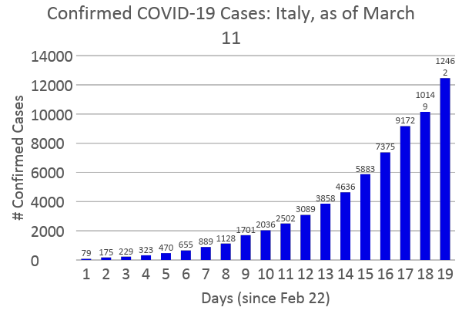
https://www.worldometers.info/coronavirus/country/italy/

Slide 6
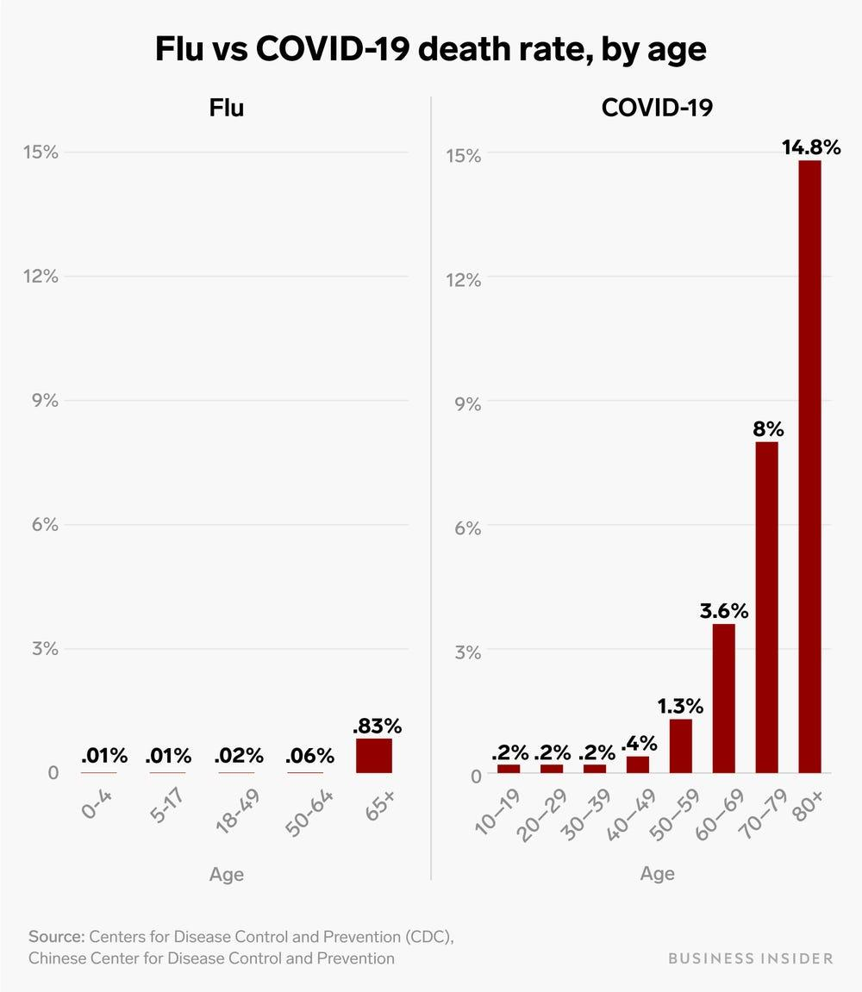
W.H.O. estimates ~3.5% mortality across age groups; age 60+ and those with underlying conditions are the most impacted.
10x – 30x mortality compared to seasonal flu
Reminder:
0.2% > 0.02% > 0%

Slide 7
- Where is Holy Cross now?
Housekeeping is working overtime shifts
Campus has ~ 6 beds available for isolation / quarantine; respirators? ICU?
Protocol for even a single student COVID positive would likely require more capacity than available
Worst case scenario: If every student was infected, there might be 0.002 x 3000 = approx. 6 deaths, even though 18-22 year olds have a very low overall death rate (.2%) from COVID-19.
Others in community are much more at risk

Slide 8
Holy Cross’s COVID-19 / Corona Virus Response
Priorities, in order:
(1) Health & well-being of students, faculty, and staff including: international students, housekeeping staff, dining staff, library staff, foreign-language assistants, tutors, groundskeepers, public safety officers
(2) Enabling students to complete academic programs
(3) Daily operations admissions, public safety, building & grounds, maintenance, construction, etc.
(4) Campus life, events, and activities
The College has decided it is wise to sacrifice (4) and (3) (to an extent) and focus on (2) and (1) at this time.

