Slide 1
Graphics CSCI 343, Fall 2023 Lecture 23 Curves and Surfaces II
Notes:
1

Slide 2
Bezier Curves
Problem with Hermite Curves: We may not know the derivative of the optimal curve. We may only have a set of data points.
Bezier curves use data from a set of 4 data points, and approximate the derivatives using the difference between adjacent points.
Bezier curves do not require the curve to pass through the middle pair of points. Instead they use these points to estimate the derivatives at the end points.

Slide 3
Setting up the equations
p₁
p₂
p'(0) = (p₁ - p₀)/(1/3) = 3(p₁ - p₀)
p'(1) = (p₃ - p₂)/(1/3) = 3(p₃ - p₂)
p₀
p₃
p(u) = c₀ + c₁u + c₂u² + c₃u³
p'(u) = c₁ + 2c₂u + 3c₃u²
p(0) = p₀ = c₀ p(1) = p₃ = c₀ + c₁ + c₂ + c₃
p'(0) = 3(p₁ - p₀) = c₁ p'(1) = 3(p₃ - p₂) = c₁ + 2c₂ + 3c₃

Slide 4
The Matrix Equations
From the previous equations, we can solve for p's:
p₀ = c₀
p₁ = c₀ + (1/3)c₁
p₂ = c₀ + (2/3)c₁ + (1/3)c₂
p₃ = c₀ + c₁ + c₂ + c₃
Therefore,
p = Ac
A = ?
c = M_{B}p

Slide 5
The Bezier Blending Functions
As before, we can write the equation for our curve in terms of blending functions:
p(u) = u^{T}M_{B}p = b(u)^{T}p
b(u) are Bernstein polynomials
Bernstein polynomials have zeros only at u=0 and u=1.
The sum of all the polynomials equals 1.
Therefore p(u) is inside the convex hull formed by the control points.
Bezier blending functions are smoother than interpolation functions.

Slide 6
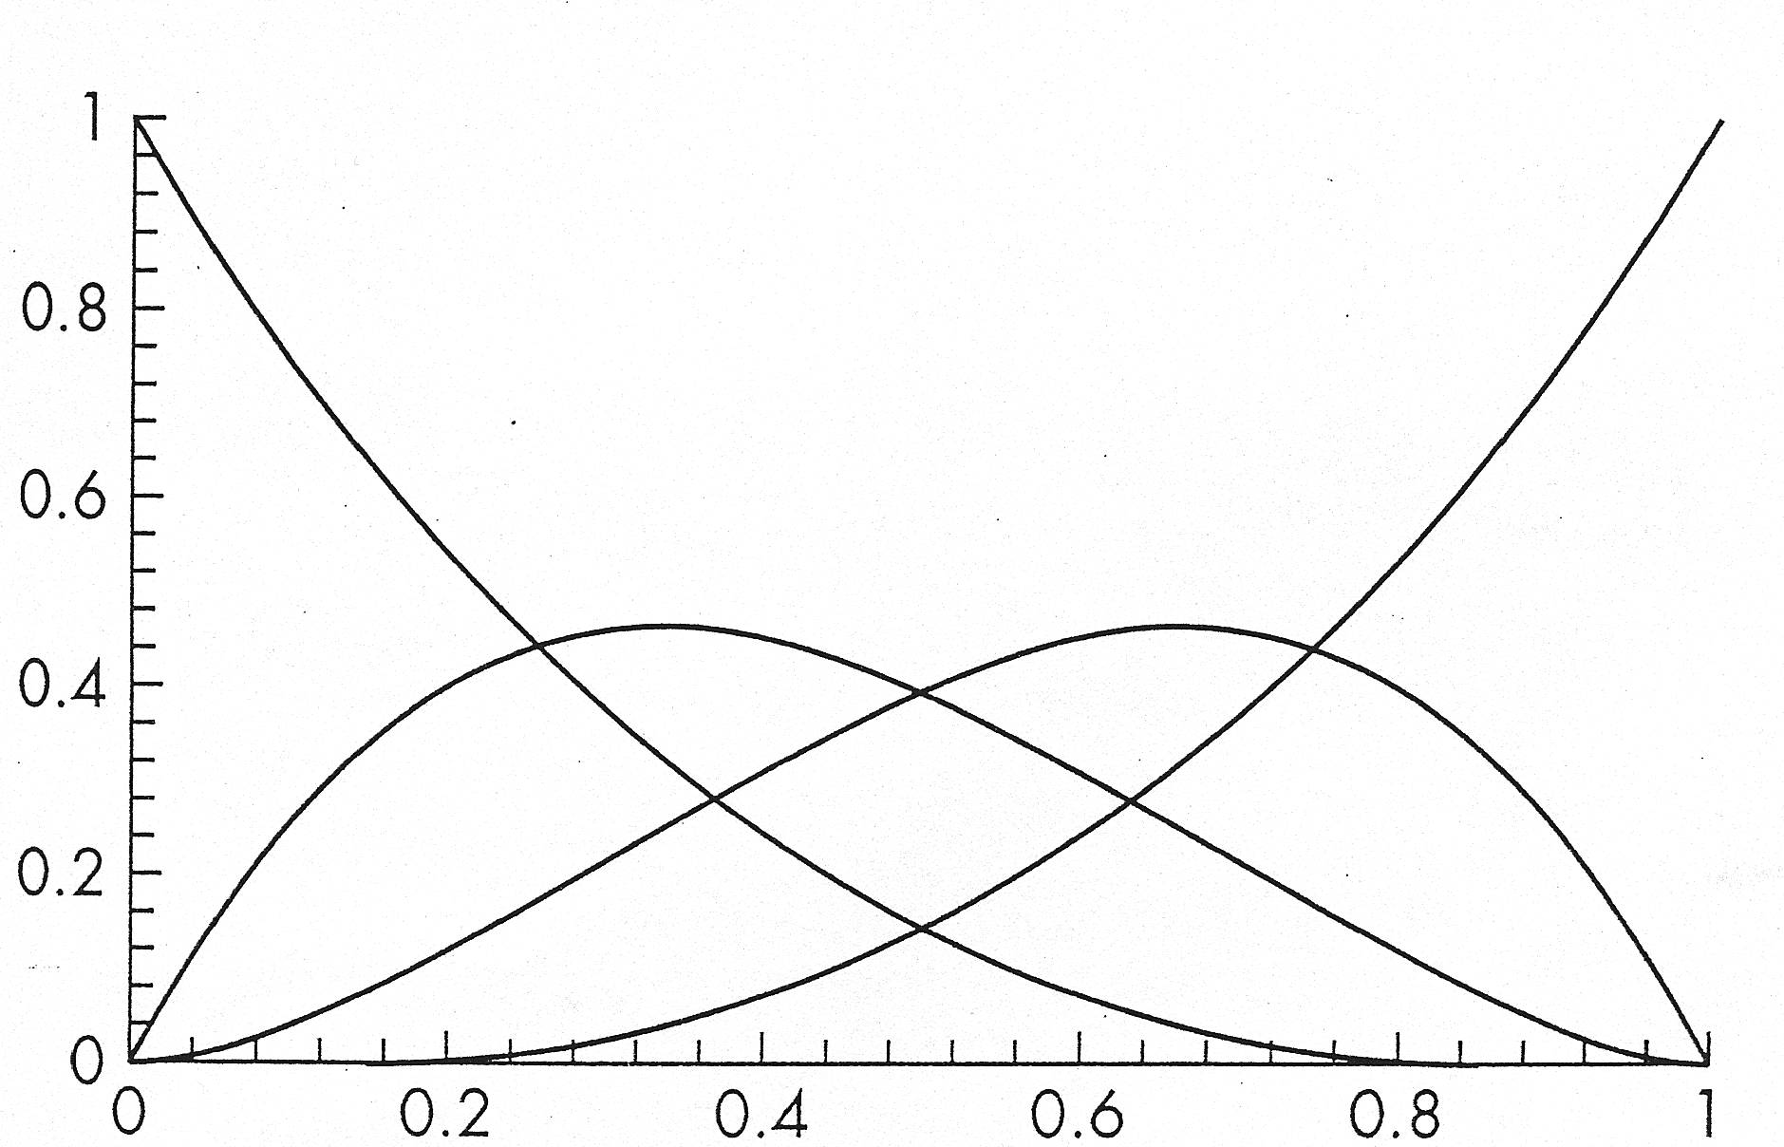
Graphs of Bezier Blending Functions

Slide 7
Approximating derivatives for the Surface patch
The Bezier surface patch interpolates between P₀₀, P₀₃, P₃₀, P₃₃
This provides 4 of the 16 equations needed. The other 12 are provided by approximations of the derivatives using the 12 other data points
p₃₀
p₃₃
p₂₀
p₁₀
p₀₀
p₀₃

Slide 8
Bezier Surface Patch equations
As with interpolation, we can create Bezier surface patches using a 4 x 4 array of control points.
P = [p_{ij}], where 0 <= i, j <= 3
The Bezier patch is given by:
p(u, v) = u^{T}Cv = u^{T}M_{B}PM_{B}^{T}v
Or in terms of blending functions:
The Bezier surface lies within a convex hull of the 16 control points.

Slide 9
Levels of Continuity
When joining two curve segments, we can have different levels of continuity.
Parametric continuity:
C⁰ continuity: The resulting curve is continuous at the join point (but not necessarily smooth).
C¹ continuity: The resulting curve is continuous and the derivatives of the two segments match at the join point.
C² continuity: The curve is continuous, the derivatives and the 2nd derivatives match at the join point.
Geometric continuity:
G⁰: The same as C⁰
G¹: The curve is continuous. The derivatives have the same direction, but may have different magnitudes.

Slide 10
Continuity of Interpolation, Hermite and Bezier curves
Interpolation: Continuous, but not necessarily smooth: C⁰
Hermite: Can make derivatives match at join point: C¹
Bezier: The derivative does not necessarily match at the join point: C⁰
We would like a method that provides smooth continuity at the join points, like Hermite curves, but that uses data from a set of points, like Bezier curves.
Splines provide such a method, and provide C² continuity.

Slide 11
Splines
Splines use a set of 4 control points to create a curve interpolated between the middle pair of points.
Splines do not require that the curve pass through any of the control points--only that it comes close to them.
p₁
p₂
p₃
p₀
Given the points {p_{i-2}, p_{i-1}, p_{i}, p_{i+1}}, we create a curve for 0 <= u <= 1 between the points p_{i-1} and p_{i}

Slide 12
Joining the segments
We can create an adjoining segment by adding one data point, p_{i+2}, and using the points {p_{i-1}, p_{i}, p_{i+1}, p_{i+2}} to create the segment between p_{i} and p_{i+1}.
p₁
p₂
p₃
p₀
p₄
Similarly, the previous segment uses {p_{i-3}, p_{i-2}, p_{i-1}, p_{i}} to create the curve between p_{i-2} and p_{i-1}.
We develop the equations so that the join point between segments is continuous and smooth.

Slide 13
Generating the spline equations
p_{i-2}
p_{i-1}
p_{i}
p_{i-3}
q
p_{i+1}
p
Two curve segments: q and p, each defined for 0 <= u <=1
Continuity: q(1) = p(0) = (1/6)(p_{i-2} + 4p_{i-1} + p_{i})
Choose weighted function between control points.
Smoothness: q'(1) = p'(0) = (1/2)(p_{i} - p_{i-2})
These are not unique choices, but they work well.
By symmetry, choose equations for p(1) and p'(1):
p(1) = (1/6)(p_{i-1} + 4p_{i} + p_{i+1})
p'(1) = (1/2)(p_{i+1} - p_{i-1})

Slide 14
The B-spline Geometry Matrix
Recall that p(u) = c₀ + c₁u + c₂u² + c₃u³, p'(u) = c₁ + 2c₂u + 3c₃u²
For 4 points {p₀, p₁, p₂, p₃} we have:
p(0) = c₀ = (1/6)(p₀ + 4p₁ + p₂)
p'(0) = c₁ = (1/2)(p₂ - p₀)
p(1) = c₀ + c₁ + c₂ + c₃ = (1/6)(p₁ + 4p₂ + p₃)
p'(1) = c₁ + 2c₂ + 3c₃ = (1/2)(p₃ - p₁)
Solving for c_{i} in terms of p gives:
c = M_{S}p
p(u) = u^{T}c = u^{T}M_{S}p

Slide 15
Spline Blending Functions
As with the other methods, we can write the spline equations in terms of blending functions:
p(u) = u^{T}M_{S}p = b(u)^{T}p
Splines require more computation than Bezier curves because each segment only spans 2 points (instead of 4).

Slide 16
Rendering Curves--Method 1
One way to render curves, once p(u) is known, is to evaluate p(u) for several values of u, and draw line segments between these points.
The finer the divisions of the curve (the more values of u), the better the rendering will look.
We can make the computations somewhat more efficient by grouping the terms so that only 3 multiplications are performed:
p(u) = c₀ + uc₁ + u²c₂ + u³c₃ = c₀ + u(c₁ + u(c₂ + uc₃))
This is still not very computationally efficient.

Slide 17
Recursive subdivision of Bezier polynomials
p₁
p₂
l₂
r₁
l₁
r₂
l₃=r₀
p(u) = b(u)^{T}p,
p₀
l₀
r₃
p₃
Divide curve into 2 halves (l and r)
Compute new control points for each half curve:
l(0) = l₀ = p₀ = p(0)
l(1) = l₃ = p(1/2) = (1/8)(p₀ + 3p₁ + 3p₂ + p₃)
l'(0) = 6(l₁ - l₀) = p'(0) = 3(p₁ - p₀)
l'(1) = 6(l₃ - l₂) = p'(1/2) = (3/4)(-p₀ - p₁ + p₂ + p₃)
Solve algebraically for l₀, l₁, l₂ and l₃
Similarly solve for r₀, r₁, r₂ and r₃
Keep dividing until reach some criterion, e.g. flatness or number of divisions.

Slide 18
Ending the recursion
Keep dividing the curves recursively until reach some criterion.
One criterion: Divide until the curve is close to flat.
Measure how far l₁ and l₂ are from the line between l₀ and l₃. When this is small, stop dividing.
Alternative Criterion: Divide curves some predetermined number of times.

Slide 19
Geometric method for recursive subdivision
(p₁ + p₂)/2
p₁
p₂
l₁ = (1/2)(p₀ + p₁)
r₂ = (1/2)(p₂ + p₃)
l₂ = (1/2)(l₁ + (p₁ + p₂)/2)
r₁ = (1/2)(r₂ + (p₁ + p₂)/2)
l₃ = r₀ = (1/2)(l₂ + r₁)
l₂
r₁
l₁
r₂
l₀
l₃=r₀
r₃
p₀
p₃
This method is computationally more efficient.
Once the subdivisions have been calculated, use gl.LINE_STRIP to connect the control points.

Slide 20
Example
Given the following 4 points, compute the new sets of control points l₀, l₁, l₂, l₃ and r₀, r₁, r₂ and r₃ for the geometric method of subdividing a bezier curve.

