Slide 1
Graphics CSCI 343, Fall 2023 Lecture 22 Curves and Surfaces I
Notes:
1

Slide 2
Curves and Surfaces
Until now, we have constructed curves and surfaces by rendering many line segments or polygons.
Sometimes it is easier to create and manipulate curves or surfaces directly, and divide them into lines or polygons just before rendering.
We will consider techniques for generating 2D curves that fit a series of data points.
These techniques can be extended to 3D surfaces.

Slide 3
Implicit representations
Many curves can be represented implicitly:
f(x, y) = 0
Examples:
ax + by + c = 0 Representation of a line
x² + y² - r² = 0 Representation of a circle with radius r.
In 3D, surfaces are represented as:
f(x, y, z) = 0
Examples:
ax + by + cz + d = 0 Representation of a plane
x² + y² + z² - r² = 0 Representation of a sphere with radius r
(Quadric surfaces: each term can have degree up to 2--cones, disks, etc.)

Slide 4
Parametric Representations
The value of each component (x, y, z) depends on an independent variable, u (the parameter).
x = x(u)
y = y(u)
z = z(u)
y
p(u)
x
z
y
Derivative:
Direction = tangent
Magnitude = speed that curve changes with u.
p(u)
x
z

Slide 5
Parametric representations of surfaces
Surfaces require 2 parameters:
Derivatives define tangent to the surface at a point.

Slide 6
Criteria for choosing a representation
Parametric forms are not unique. Many different representations are possible for a single curve.
Criteria for a good representation:
Local control of shape
Smoothness and continuity
Ability to evaluate derivatives
Stability
Ease of Rendering
Parametric curves that are polynomials in u satisfy many of these criteria:
x(u) = c₀ + c₁u + c₂u² + ... + c_{n}u^{n}

Slide 7
Matrix Equation for parametric curve
We can write the 3 equations for x(u), y(u) and z(u) in one matrix equation:

Slide 8
Multiple curve segments
We usually want to define a curve segment between two endpoints. We define the curve between u=0 and u=1, so that:
p(0) = p₀ and p(1) = p₁
p₁ = p(1)
p₀ = p(0)
Longer curves are composed of multiple segments. We would like the connection between curves to be as smooth as possible
Join point
Not smooth
Discontinuous derivative
Smooth join

Slide 9
Degree of the Polynomial
What degree should our polynomial representation have?
Tradeoff:
High degree can have rapid changes and lots of turns, but it requires more computation and curve may not be as smooth.
Low degree means a smoother curve, but it may not fit the data as well.
Compromise: Use low degree polynomials with short curve segments. Cubic polynomials work well.
p(u) = c₀ + c₁u + c₂u² + c₃u³
where

Slide 10
Matrix Equation for Cubic representation
x(u) = c_{x0} + c_{x1}u + c_{x2}u² + c_{x3}u³
Find values for c's that create the desired curve segment.
1 point gives 3 equations and 12 unknowns.
y(u) = c_{y0} + c_{y1}u + c_{y2}u² + c_{y3}u³
z(u) = c_{z0} + c_{z1}u + c_{z2}u² + c_{z3}u³
p(u) = c₀ + c₁u + c₂u² + c₃u³

Slide 11
Interpolation
If one point provides 3 equations and 12 unknowns, then 4 points provide 12 equations with 12 unknowns.
We can choose any value of u to correspond to the 4 points, so we will choose to divide the interval 0 to 1 evenly (0, 1/3, 2/3, 1).

Slide 12
Writing the Matrix equations
Note that the equation: p₃ = c₀ + c₁ + c₂ + c₃ actually embodies 3 independent equations.

Slide 13
Matrix Equations (continued)
Equations for 4 points:
p₀ = p(0) = c₀
p₁ = p(1/3) = c₀ + c₁(1/3) + c₂(1/3)² + c₃(1/3)³
p₂ = p(2/3) = c₀ + c₁(2/3) + c₂(2/3)² + c₃(2/3)³
p₃ = p(1) = c₀ + c₁ + c₂ + c₃
We can write this as
p = Ac
where:
A= ?

Slide 14
Solving for c
p = Ac
c = ?
The interpolating geometry matrix:
Once we know c, we know the equations for x(u), y(u), z(u).

Slide 15
Example of Interpolation
Given the following 4 data points, compute the functions, x(u), y(u) and z(u) for the cubic curve that interpolates between the points.

Slide 16
Working with more than 4 points
When working with more than 4 points, we find curves for each group of 4.
1st curve: p₀, p₁, p₂, p₃
2nd curve: p₃, p₄, p₅, p₆
p₃
p₄
p₁
p₆
p₀
p₂
p₅
Note that the join won't necessarily be smooth.

Slide 17
Blending Functions
We can express the desired curve in terms of a set of functions, known as blending functions.
p(u) = u^{T}c = u^{T}(M_{I}p) = (u^{T}M_{I})p = b(u)^{T}p
where:
Therefore, we can express the curve as:
p(u) = b₀(u)p₀ + b₁(u)p₁ + b₂(u)p₂ + b₃(u)p₃

Slide 18
Finding the Blending functions
Multiplying it out gives:
b₀(u) = 1 - 5.5u + 9u² - 4.5u³, etc.
Factoring gives:
b₀(u) = -(9/2)(u-1/3)(u-2/3)(u-1)
b₁(u) = (27/2)u(u-2/3)(u-1)
b₂(u) = -(27/2)u(u-1/3)(u-1)
b₃(u) = (9/2)u(u-1/3)(u - 2/3)

Slide 19
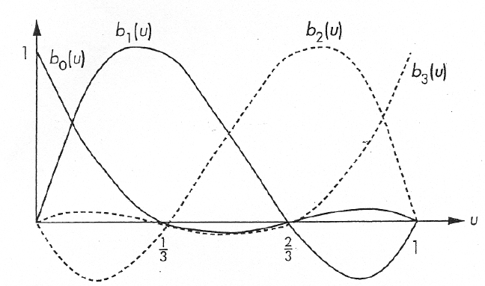
The interpolation blending functions

Slide 20
Interpolation for a Surface Patch
Interpolation can be extended to cover a surface patch:
c_{ij} is the 3 element matrix of x, y and z coefficients of the ij^{th} term in the polynomial.
Define C = [c_{ij}] as a 4x4 matrix containing the coefficients, c_{ij}
p(u, v) = u^{T}Cv

Slide 21
How many Points do we need?
p(u, v) = u^{T}Cv
The patch is defined by the coefficients, c_{ij}, in C. There are 16 of these coefficients, each with an x, y and z component for a total of 48 unknowns.
Each point, p, provides 3 equations (for x, y and z). Therefore, we need 16 points p_{ij} to define the interpolating patch.
p₃₀
p₃₃
Now have 3 sets of 16 equations.
= 48 equations and 48 unknowns.
p₂₀
p₁₀
p₀₀

Slide 22
Solving for C
We can show that
C = M_{I}PM_{I}^{T}
Therefore, p(u, v) = u^{T}Cv = u^{T}M_{I}PM_{I}^{T}v
As with curves, we can rewrite this in terms of blending patches:

Slide 23
Hermite Curves
Problems with Interpolation:
Functions not very smooth
Join points may not be smooth (may have discontinuous derivatives)
Hermite Curves address the second problem by using the derivatives at the endpoints of the curves (in place of the 2 internal data points).
p(u) = c₀ + c₁u + c₂u² + c₃u³
p'(u) = c₁ + 2c₂u + 3c₃u²
p(0) = p₀ = c₀ p(1) = p₃ = c₀ + c₁ + c₂ + c₃
p'(0) = c₁ p'(1) = c₁ + 2c₂ + 3c₃

Slide 24
Solving for c
c = A⁻¹q = M_{H}q
p(u) = u^{T}c = u^{T}M_{H}q
Blending functions:
p(u) = u^{T}M_{H}q = b(u)^{T}q, where

