Slide 1
Computers and Society
HNRS 299, Spring 2017
Session 19
HTML
Notes:
1

Slide 2
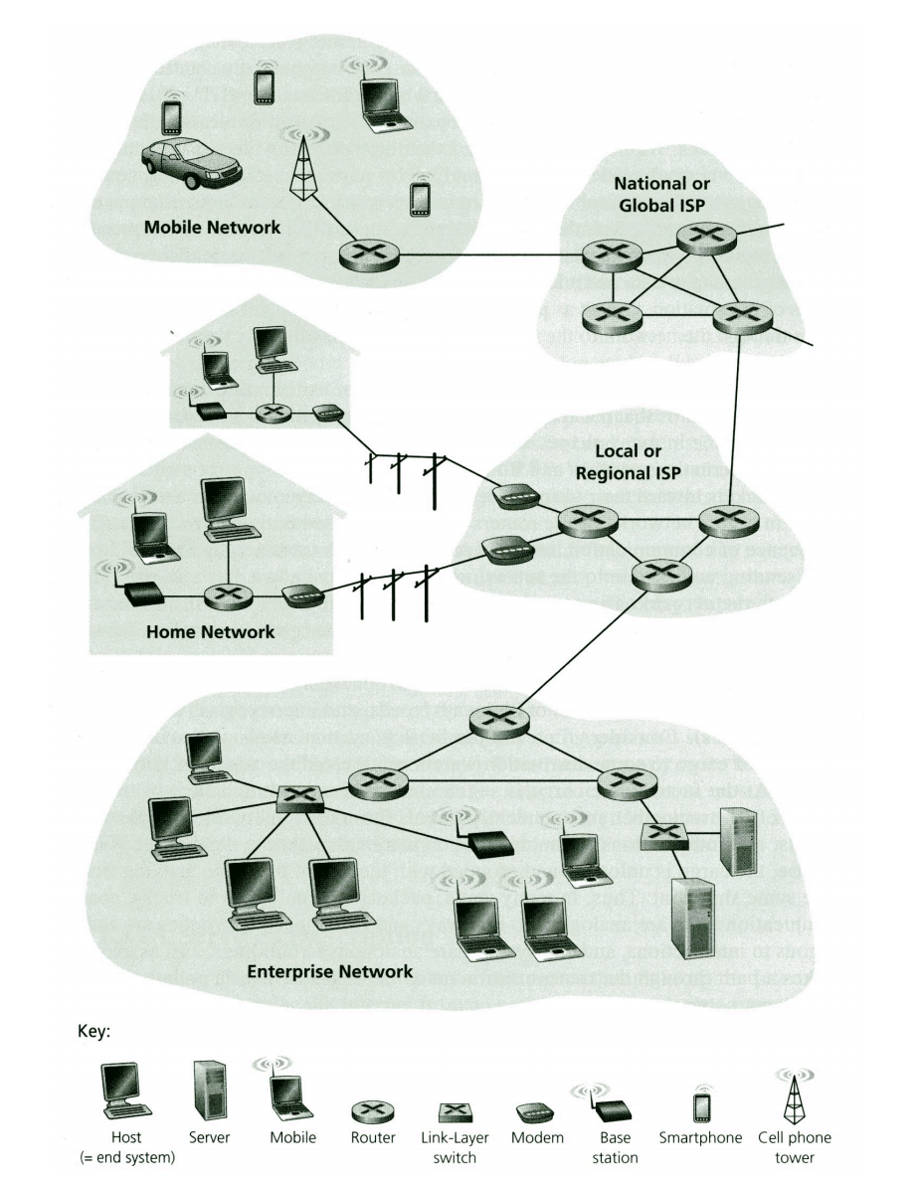
What is the Internet?
A system of interconnected computer networks that link together billion of devices using the TCP/IP communication protocols.

Slide 3
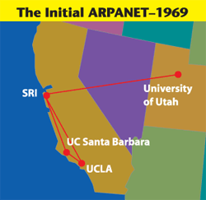
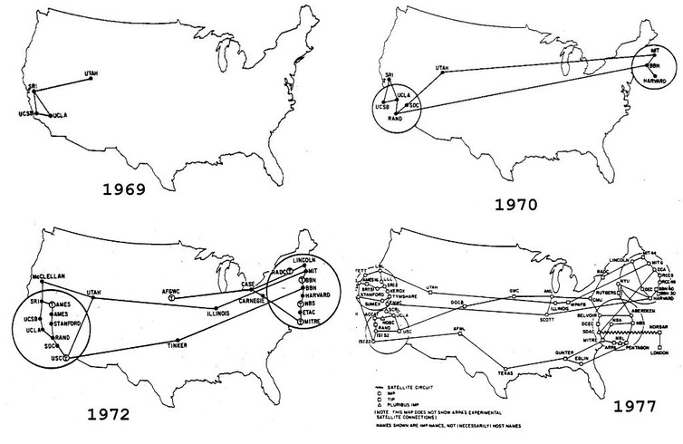
History of the Internet
1. The internet started as ARPAnet (Advanced Research Projects Agency).

Slide 4
History of the Internet
2. Other networks started forming: bitnet, CSnet, NSFnet, etc.
3. These networks became interconnected to form the internet.
4. Several organizations oversee the internet:
Internet Society
Internet Corporation for
Assigned Names and Numbers (ICANN)
Network Information Services

Slide 5
TCP/IP
The Internet is a Packet Switched Network--messages are sent as packets.
Messages are sent across the web using the TCP/IP protocols
Transmission Control Protocol (TCP) breaks up the messages and puts on header information regarding the order of packets and for error checking.
Internet Protocol (IP) addresses the packets and sends them across the internet. The packets don’t all necessarily follow the same route or arrive in the correct order.
IP unpacks the packets at their destination.
TCP puts the packets in their proper order at the end.

Slide 6
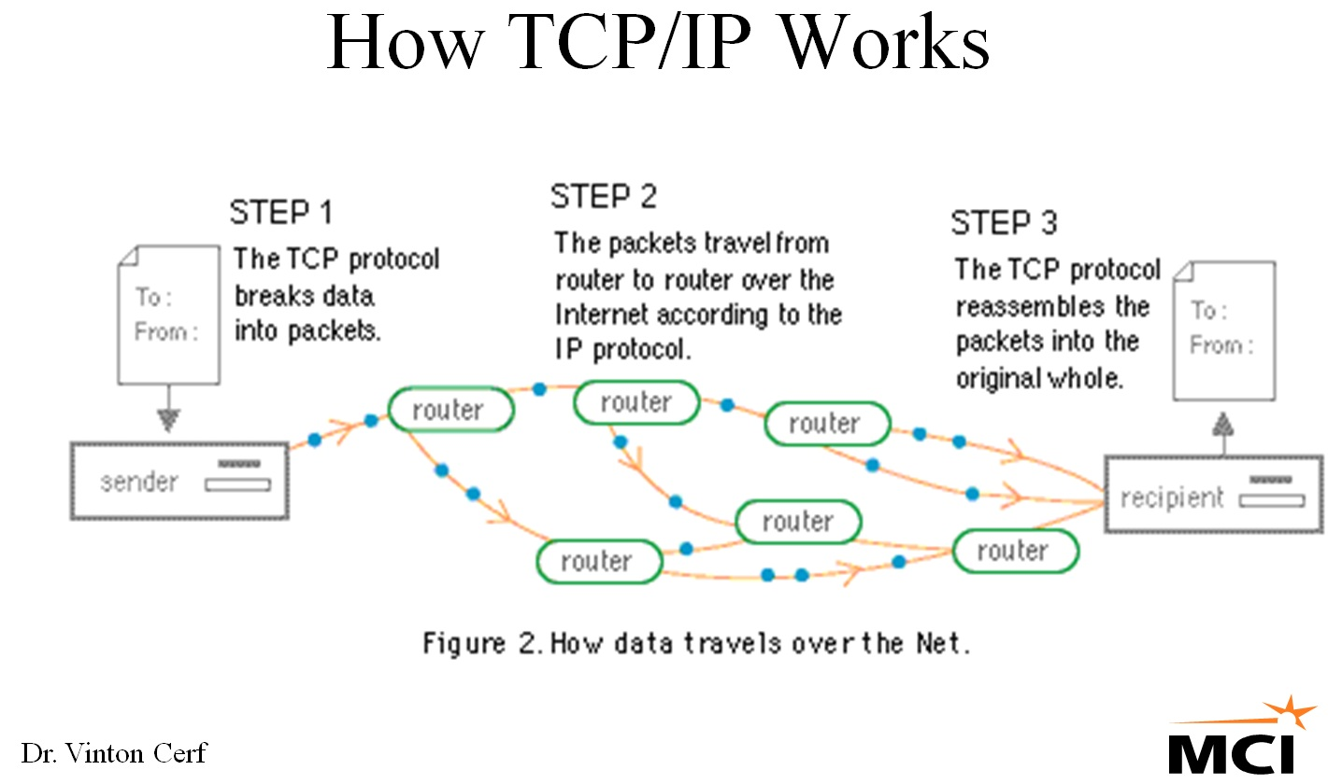
TCP/IP

Slide 7
The World Wide Web

Slide 8
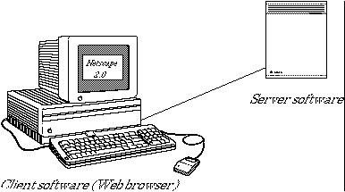
The Client/Server Model

Slide 9
Universal Resource Locators
The user specifies a URL either by typing it into the location box or by clicking on a link.
www.december.com
Identifies Web server
index.html
Specific file requested
http://www.december.com/web/text/index.html
http://
What internet protocol to use
/web/text
Directory pathname

Slide 10
The request goes out

Slide 11

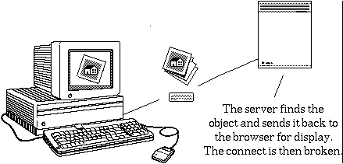
May I Help You?

Slide 12
Browsers

Slide 13
Hypertext Markup Language

Slide 14
Boiler plate
<HTML>
<HEAD>
<TITLE>My Home Page</TITLE>
</HEAD>
<BODY>
<H1>Welcome to my homepage!</H1>
<P>
Hi there! This is my very first web page!
</BODY>
</HTML>
index.html

Slide 15
HTML Blocks

Slide 16
Adding Graphics

Slide 17
Creating Hyperlinks

Slide 18
Relative addressing
Relative addressing specifies a location relative to the location of the html file. Slashes indicate directory locations:
<IMG SRC = "moon.gif">
(moon.gif is in the same directory (folder) as the html file that contains this tag).
<IMG SRC = "pictures/cookie.gif">
(cookie.gif is in a directory named pictures that is in the same directory as the html file that contains this tag)
index.html
moon.gif
cookie.gif
pictures

Slide 19
Absolute Addressing
Absolute addressing gives the complete web address of a file:
<IMG SRC = "http://mathcs.holycross.edu/~croyden/croyden.gif">
The browser will download the image from the address given in the img tag.

Slide 20
Some Common Tags
Start a paragraph: <P>
Force a new line: <BR>
Bold Text: <B>bold text</B>
Italics: <I>Italics</I>
Centered Text: <CENTER>Centered text</CENTER>
Headlines: <H1>Big Headline</H1>
...
<H6>Little headline</H6>
Unordered List: <UL>
<LI> Item 1
<LI> Item 2
</UL>

Slide 21
The FONT Tag
The <FONT> tag allows you to specify font types, sizes and colors:
Specifying font type:
<FONT FACE = "Arial">Arial font</FONT>
Specifying font size:
<FONT SIZE = 6>A big font</FONT>
or:
<FONT SIZE = +2>Increase the size a little</FONT>
Specifying font color:
<FONT COLOR = "red">Red text </FONT>

Slide 22
Dealing with White Space
Browsers ignore white space (spaces, tabs, new lines, etc.)
Text fills in to the right edge of the browser window, and then the browser wraps the text to the next line.
What if you want white space?
Option 1:
Use &nbsp; to indicate a space
Option 2:
Use <PRE> ...</PRE> (preformatted text)

Slide 23
Inserting Links and Graphics
Inserting a link:
<TD><A HREF = "http://www.holycross.edu">
Holy Cross</A></TD>
Adding an image:
<TD><IMG SRC = "gdome.gif"></TD>

Slide 24
A Simple Table
<TABLE>
<TR>
<TD> Holy Cross </TD>
<TD> Boston College</TD>
<TD> WPI </TD>
</TR>
<TR>
<TD> 75% </TD>
<TD> 07%</TD>
<TD> 17% </TD>
</TR>
</TABLE>
Holy Cross Boston College WPI
75% 07% 17%

Slide 25
Adding a Border
Changing Cell Size
<TABLE BORDER = 2>
<TR>
<TD> Holy Cross </TD>
<TD> Boston College</TD>
<TD> WPI </TD>
</TR>
<TR>
<TD WIDTH = 120 HEIGHT = 100> 75% </TD>
<TD> 07%</TD>
<TD> 17% </TD>
</TR>
</TABLE>
Holy Cross Boston College WPI
75% 07% 17%

Slide 26
Changing Alignment
Coloring a Cell
Changing Horizontal Alignment:
<TD ALIGN = LEFT>
<TD ALIGN = CENTER>
<TD ALIGN = RIGHT>
Changing Vertical Alignment:
<TD VALIGN = TOP>
<TD VALIGN = MIDDLE>
<TD VALIGN = BOTTOM>
Coloring a cell:
<TD BGCOLOR = BLUE>

Slide 27
The WebCrawler
def spider(url, word, maxPages):
pagesToVisit = [url]
numberVisited = 0
foundWord = False
while numberVisited < maxPages and pagesToVisit != [] and not foundWord:
numberVisited = numberVisited +1
foundWord = False
# Start from the beginning of our collection of pages to visit:
url = pagesToVisit[0]
pagesToVisit = pagesToVisit[1:]

Slide 28
The WebCrawler
try:
print numberVisited, "Visiting: " + url
parser = LinkParser()
data, links = parser.getLinks(url)
pagesToVisit = pagesToVisit + links
if data.find(word)>-1:
foundWord = True
print " **Success!**"
except:
print " **Failed!**"
if foundWord:
print "The word " + word + " was found at " + url
else:
print "Word not found"
spider("http://mathcs.holycross.edu/~csci343", "computer", 20)

Slide 29
The Parser
from HTMLParser import HTMLParser
from urllib2 import urlopen
from urllib2 import urlparse
class LinkParser(HTMLParser):
def handle_starttag(self, tag, attrs):
if tag.lower( ) =='a' or tag.lower( ) == 'link':
for (key, value) in attrs:
if key.lower( )=='href':
newUrl = urlparse.urljoin(self.baseUrl, value)
self.links = self.links + [newUrl]

Slide 30
Getting links
def getLinks(self, url):
self.links = []
self.baseUrl = url
response = urlopen(url)
contentType = response.info().getheader('Content-Type')
if contentType[0:9] =='text/html':
htmlBytes = response.read()
# Note that feed() handles Strings well, but not bytes
# (A change from Python 2.x to Python 3.x)
htmlString = htmlBytes.decode("utf-8")
self.feed(htmlString[0:4000])
return htmlString, self.links
else:
return "",[]

